Slide 1

Python exercise 3

Slide 2
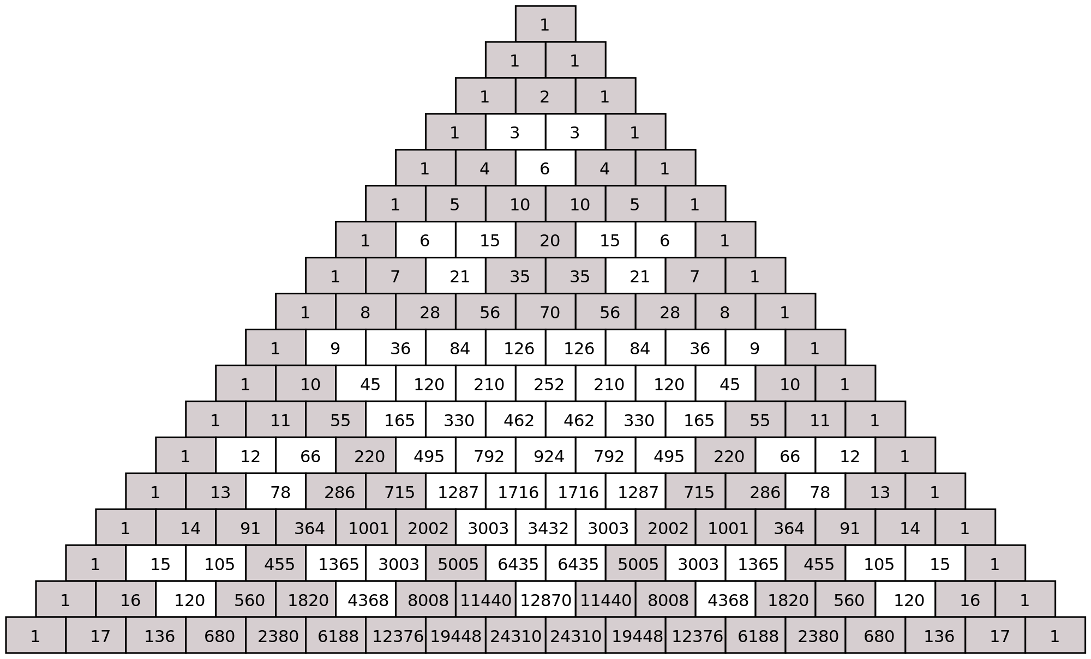
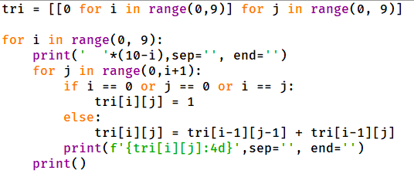
Question 1.1
Fill the blank place with missing code. The program prints the first 9 rows of Pascal Triangle numbers.

Slide 3
Question 1.2
Fill the blank place with missing code. The program prints the first 9 rows of Pascal Triangle numbers.

Slide 4
Question 1.3
Fill the blank place with missing code. The program prints the first 9 rows of Pascal Triangle numbers.

Slide 5
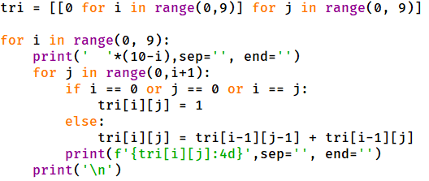
Question 1
answer.

